Slide 1
Parallel Computer Architecture/Programming Models
Introduction to Parallel and Distributed Computing

Slide 2
Learning Outcomes
Classification according to Flynn’s Taxonomy
Classification according to Memory
Shared Memory vs Distributed Memory

Slide 3
Outline
Parallel architecture types
Instruction-level parallelism
Vector processing
Classification according to Flynn’s Taxonomy
Classification according to Memory
Shared Memory vs Distributed Memory
Shared Memory
Memory organization: UMA, NUMA
Coherency: CC-UMA, CC-NUMA
Interconnection networks
Distributed memory
Clusters
Clusters of SMPs
Heterogeneous clusters of SMPs

Slide 4
Flynn’s Taxonomy and Data Parallelism
One of the more widely used parallel computer classifications, since 1966, is called Flynn’s Taxonomy
It distinguishes multiprocessor computers according to the dimensions of Instruction and Data
Instructions
Single (SI)
Multiple (MI)
Single (SD)
SISD Single-threaded process | MISD Pipeline architecture
SIMD Vector Processing | MIMD Multi-threaded Programming
SISD: Single instruction stream, Single data stream
SIMD: Single instruction stream, Multiple data streams
MISD: Multiple instruction streams, Single data stream
MIMD: Multiple instruction streams, Multiple data streams
Data
Multiple (MD)

Slide 5
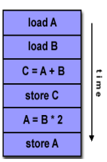
SISD Machines
A serial (non-parallel) computer
Single instruction: Only one instruction stream is acted on by CPU during any one clock cycle
Single data: Only one data stream is used as input during any one clock cycle
Deterministic execution
Oldest and most prevalent form computer
Examples: Most PCs, single CPU
workstations and mainframes
Processor
D
D
D
D
D
D
D
Instructions

Slide 6
SIMD Machines (I)
A type of parallel computers
Single instruction: All processor units execute the same instruction at any give clock cycle
Multiple data: Each processing unit can operate on a different data element
It typically has an instruction dispatcher, a very high-bandwidth internal network, and a very large array of very small-capacity instruction units
Best suitable for specialized problems e.g., image processing
Two varieties: Processor Arrays and Vector Pipelines
Examples: Connection Machines, MasPar-1, MasPar-2;  IBM 9000, Cray C90, Fujitsu VP, etc

Slide 7
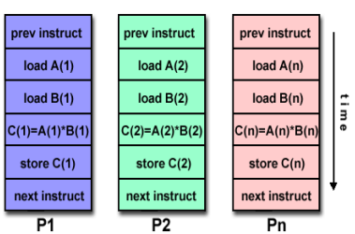
SIMD Machines (II)

Slide 8
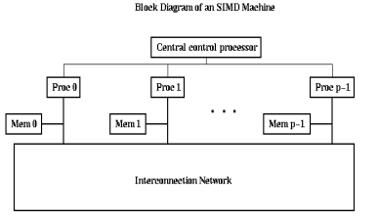
SIMD Machines (III)

Slide 9
MISD Machines (I)
A single data stream is fed into multiple processing units
Each processing unit operates on the data independently via independent instruction streams
Very few actual machines: CMU’s C.mmp computer (1971)
Possible use: multiple frequency filters operating on a single signal stream

Slide 10
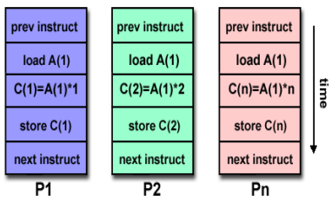
MISD Machines (II)

Slide 11

MIMD Machines (I)
Multiple instruction: Every processor may execute a different instruction stream
Multiple data: Every processor may work with a different data stream
Execution can be synchronous or asynchronous, deterministic or nondeterministic
Examples: most current supercomputers, grids, networked parallel computers, multiprocessor SMP computer

Slide 12
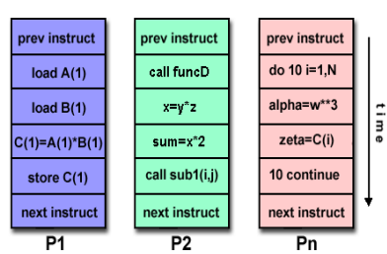
MIMD Machines (II)

Slide 13
Parallel vs. Distributed
Processor
D
D
D
D
D
D
D
Shared
Memory
Instructions
Network connection for data transfer
Processor
D
D
D
D
D
D
D
Instructions
Parallel: Multiple CPUs within a shared memory machine
Distributed: Multiple machines with own memory connected over a network

Slide 14
Data Parallel Architectures
Array of simple processors with memory
Processors arranged in a regular topology
Control processor issues instructions
Specialized synchronization and communication
Specialized reduction operations
Array processing

Slide 15
Next Class
Parallel Computer Architecture/Programming Models (Continued..)
Memory

